Slide 1

WELCOME

Slide 2
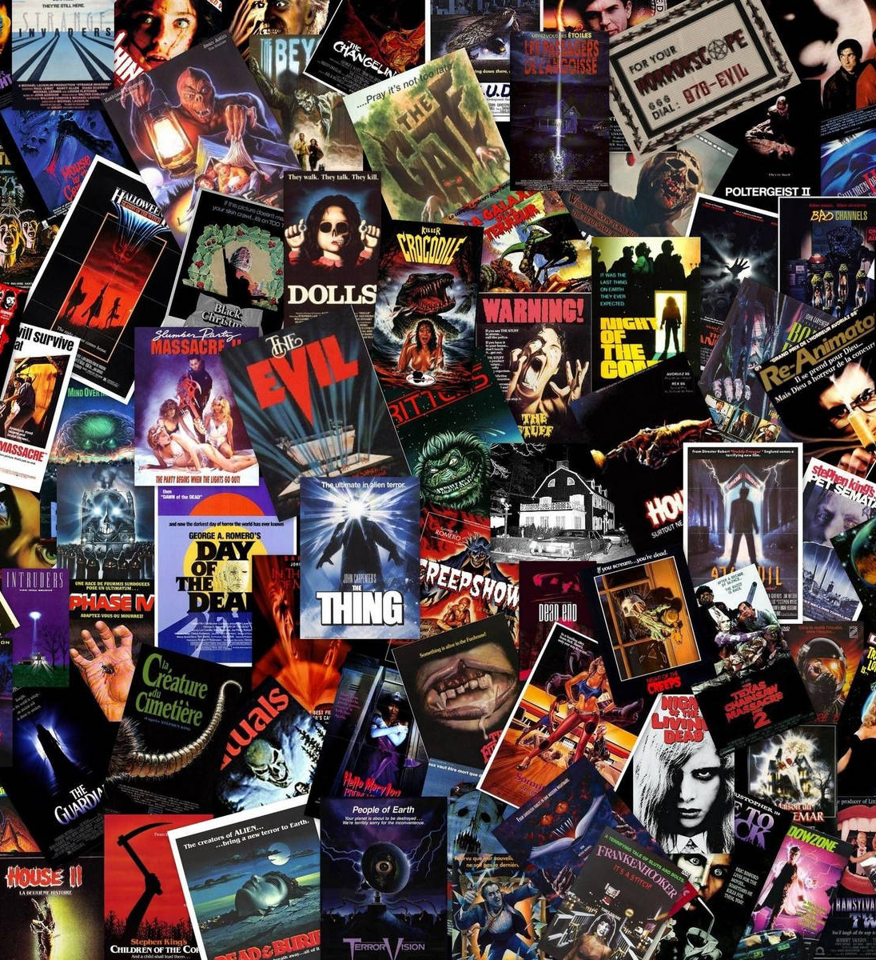
MOVIE COLLECTION DATABASE
NAME: Mohamed Ismail. N
SUBMISSION DATE: 20/09/2024

Slide 3

Aim of the project:
Create a Modular Design:
To represent different entities such as Movies, Names of the directors, and their ratings.
Manage Movie Data :
mainly for the storage purposes.
It is used to store in various entites like (Name, Genre, rating, Director, etc…).
User Management :
It helps in the User to store the Movie data and view it for the future References.

Slide 4

Problem Statement
Managing and exploring movie data efficiently is an increasingly complex task due to the growing volume of movies, genres, and user interactions. In addition to providing essential information about movies, an ideal system should allow users to rate, review, and filter movies based on their preferences. This complexity requires a well-structured, scalable system that applies object-oriented design principles to manage movie data and user interactions.

Slide 5



PROJECT
DESCRIPTION
METHODS USED IN THE PROJECT:
(OOPs) Object Oriented Programing Concept
Class has been defined
Instead of Database Dictionary is been used.
KEY FEATURES:
Multi language movie names.
Name of the movies and the Name of the directors and their ratings are in given in the form of dictionary
Created with the Help of Dictionary Concept.
Update and Delete function is been used.

Slide 6

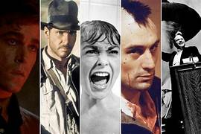
FUNCTIONALITIES:
Adding Movies to the Database.
View the details of the a specific movie by its title, director name, genre, year and its ratings.
Update the Movies or Delete the movies from the database and save it for the future References.
Store and Retrieve Movies from the Database.

Slide 7

CODE
IMPLEMENTATION
In Movie Collection Database implemented using Object-Oriented Programming (OOP), key features such as Name of the movie, Title, Review and the ratings of that particular movie can be structured into classes that represent entities in the system. Below is a detailed explanation of how such a project can be implemented, including insights into key algorithms, data structures, and code organization.
Classes
Search Movies
Update Movies
Display Movies
Delete Movies

Slide 8

RESULT AND OUTCOMES OF THE PROJECT
The Movie Collection Database project aimed to review the movie and rate the movie in its order of viewing but the user.
This shows the database has been created the the number of movies and its ratings and its reviews.

Slide 9

CONCLUSION
The Python-based Movie Database project, structured around OOP concepts, provides an efficient and organized solution for managing movie data and user interactions. It serves as a practical example of how OOP principles can be applied to build scalable, maintainable, and user-friendly software systems.

Slide 10

THANK YOU

